Slide 1
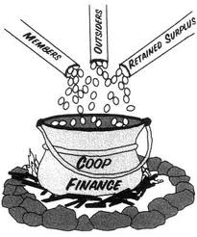
CO-OPERATIVE FINANCIAL INSTITUTIONS INDABA
14-17 OCTOBER 2014
EAST LONDON
EASTERN CAPE PROVINCE,SOUTH AFRICA
The Role of sefa as a Stakeholder in Support of the in supporting Co-operative Financial Institutions

Slide 2
PRESENTATION OUTLINE
  What is sefa and its mandate;
  Products and services offered by sefa to CFIs;
  Legislative Framework in terms of which sefa support co-operatives;
  sefa’s footprint in supporting CFIs;
  Testimony of impact made by sefa funded CFIs;and
  sefa relationship with CBDA.
  How CFIs are financed;
  Financial Sustainability of CFIs;and
  Creativity and Innovation.
N.B Financial Co-operatives and Co-operative Financial Institutions will be used interchangeably in this presentation.

Slide 3
WHAT IS sefa AND ITS MANDATE?
sefa stands for Small Enterprise Finance Agency, a company wholly-owned by Industrial Development Corporation (IDC).The company was established through the merger of Khula Enterprises, South African Microfinance Apex Fund (samaf) and IDC small business activities.
In simple language ,sefa’s mandate is to make finance accessible to SMMEs including co-operatives

Slide 4
PRODUCTS AND SERVICES OFFERED BY sefa PRIOR MERGER
PRODUCTS AND SERVICES OFFERED BY sefa PRE-MERGER
Financial support
On-lending
Capacity-Building Grant
Non-Financial Support
Training of FSPCs board, management and staff
Assistance with the registration of new FSPCs
Regulatory and supervision
Registration of new FSPCs
Supervision of existing FSPCs

Slide 5
WHAT HAS CHANGED WITH THE ESTABLISHMENT OF sefa
PRODUCTRS AND SERVICES TAKEN OVER BY sefa
Loans to FCs for on-lending
Capacity-building for acquisition of assets and subsidy for operational costs
PRODUCTS AND SERVICES TRANSFERRED TO OTHER AGENCIESOFFERED
Non-Financial Support
This function is now performed by SEDA
Regulatory and supervision
This function is now performed by CBDA

Slide 6
WHAT IS THE IMPACT OF LEGISLATION ON sefa’s MANDATE IN RELATION TO FINANCIAL CO-OPERATIVES?
Co-operatives Amendment Act, Act 6 of 2013 aims to amend the Co-operatives Act, Act No. of 2014 to ,amongst other things, to provide for the establishment ,functions and powers of Co-operatives Development Agency (CDA).
“ CHAPTER 12 A
CO-OPERATIVES DEVELOPMENT AGENCY
PART 1
Establishment ,Legal status, functions and powers of Agency
91A.The Co-operatives Development Agency is hereby established.
Objectives
91B. The objectives of the Agency are to:
(a) Support, promote and assist with the development of co-operatives;
(b) Provide financial and non-financial assistance to co-operatives to enable the development of co-operatives ,provided that deposit-taking financial co-operatives will not be eligible for financial support but will be eligible for non-financial support...”

Slide 7
WHAT IS THE IMPLICATION OF THE STATEMENT BELOW?
Statement
“….(b) Provide financial and non-financial assistance to co-operatives to enable the development of co-operatives ,provided that deposit-taking financial co-operatives will not be eligible for financial support but will be eligible for non-financial support...”
Implication
The implication of the above statement is that financial support in the form of loans and capacity-building to CFIs will be provided by sefa.

Slide 8
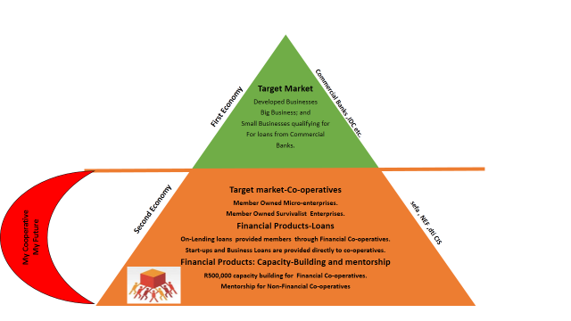
sefa TARGET MARKET AND PRODUCTS

Slide 9
sefa TARGET MARKET AND PRODUCTS
(NARRATIVE VERSION)
PRODUCTS AND SERVICES
Financial Products |  | Non-Financial support
sefa offers the following products and services: Business Loans/On-lending funds Institutional strengthening to Financial Co-operatives Mentoring to co-operatives funded through direct lending. |  | sefa does not offer these services but are offered by the following government agencies: CIPC- responsible for registration of co-operatives CBDA- responsible for regulating and supervising Financial Co-operatives including Co-operatives Banks SEDA-responsible for business support and training of co-operatives( this function to be taken over by CDA when it becomes operational)
FUNDING MODEL- CHANNELS
Direct Lending | Wholesale Lending
Business loans up to R5 million to all types of co-operatives except Financial Co-operatives. ( Financing products: bridging loan, term loan, project loan) | On-lending loans to Financial Co-operatives subject to 15% cap on external credit but the FC may apply for exemption from CBDA supervisor. R500,000 capacity-grant to start-up Financial Co-operatives to acquire systems,equipment,software and training. The following are not provided for under this scheme: Stipend/ Salaries, Office Furniture and Rental.

Slide 10
MINIMUM QUALIFYING CRITERIA FOR sefa FUNDING
(CFIs)
Duly registered with CIPC and CBDA;
Minimum membership of 200 members;
Minimum members Shares /savings to the value of R100,000;
Proof of fit and proper board of directors;
Tax Clearance Certificate;
Proof of proper systems and process in place; and
Outstanding loan book of at least R100,000.

Slide 11
sefa’s FOOTPRINT IN SUPPORTING FINANCIAL CO-OPERATIVES
N0 | Name | Province
1 | KwaZulu Ladies | KZN
2 | Kwamachi FSC | KZN
3 | Kuvhanganyani | LP
4 | Mankotsana | LP
5 | Tlharihani | LP
6 | Boikago | NW
7 | Ditsobotla Primary Co-op Bank | NW
8 | Sibanye Cape | WC
9 | Flash | WC

Slide 12
sefa’s FOOTPRINT IN SUPPORTING FINANCIAL CO-OPERATIVES
N0 | Name | Province
10 | Mmetlakhola | Gauteng
11 | Mutapa | LP
12 | Cebisa (potential) | KZN

Slide 13
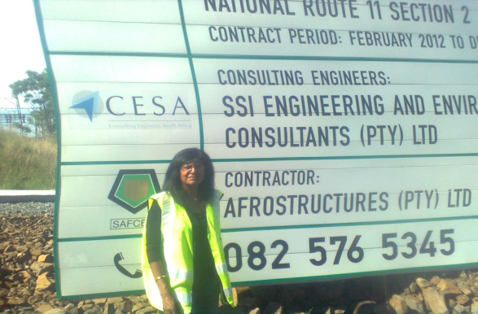
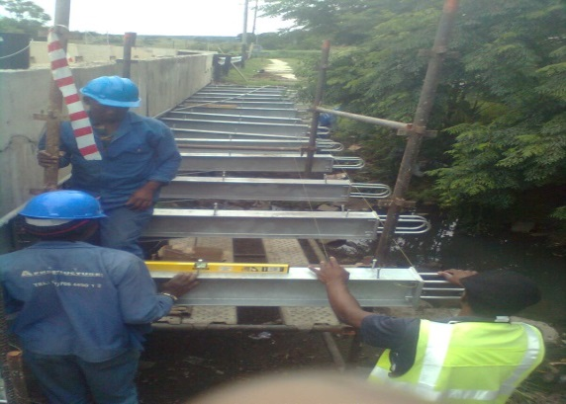
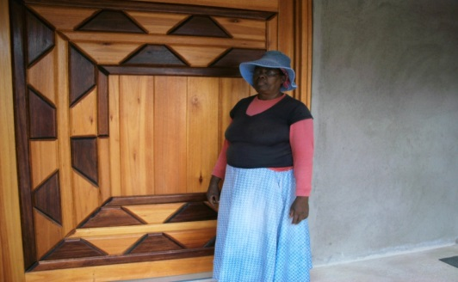
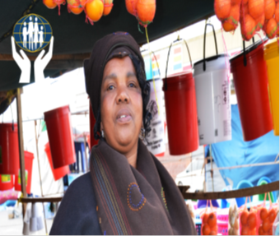
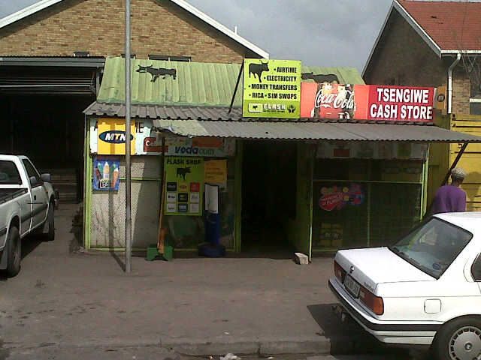
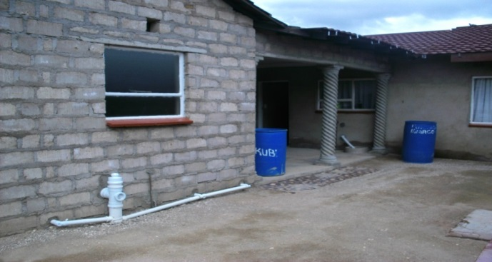
TESTIMONY OF IMPACT MADE BY sefa FUNDED FINANCIL CO-OPERATIVES
Pam Govender is a Member of K.Ladies Financial Cooperative. She is an entrepreneur and owns a construction company (Alpha Trading ) and employs four people. Her business obtains loans from K.Ladies because of being a member. Her business is involved in making gates, repair bridges etc.
The picture on the right demonstrates the work done by Alpha Trading in Ladysmith, KZN.
Pam was one of the winners of 2013 City Bank micro-entrepreneurs. K.Ladies assisted her to register for the competition.
Beauty Gcilitshana of Khayelitsha , a member of Flash , started her fruit and vegetable stall to feed her family in 2010. She is currently employing two employees. She has bought a van for her business, renovated her house and sends her kids to school. She is very happy with the SACCO’s services.
Ms. Rachidi M.Hellen is a member of Mankotsana Financial Co-op based in Limpopo .She received a loan from the co-operative in 2012 to extend her house. She has now achieved her goal of having a decent house. The picture below shows the house at the time of the extension.
Flash is one of biggest Financial Co-ops funded by sefa and has approximately 9000 members who are SMMEs.The members are Flash Vendors who sell electricity and airtime.
sefa approved a total amount of R4 million i.e. R2 million on-lending loan and R2 million capacity-building grant. A total amount of R3, 723,665 was disbursed. The current exposure to sefa stands at R276, 335.

Slide 14
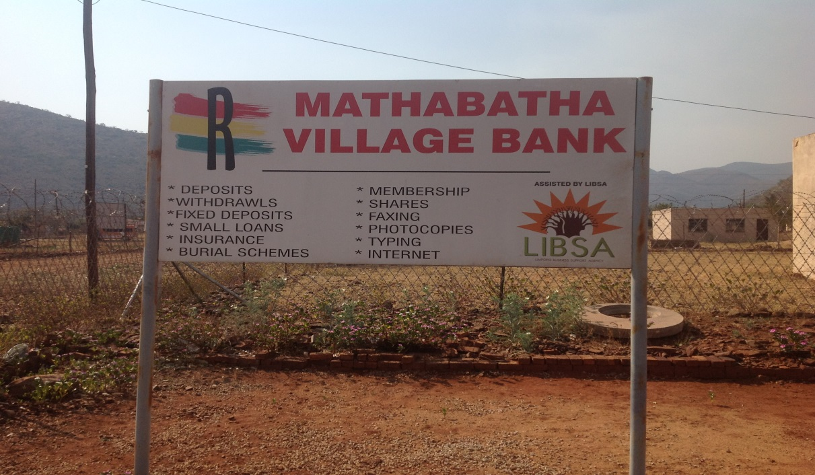
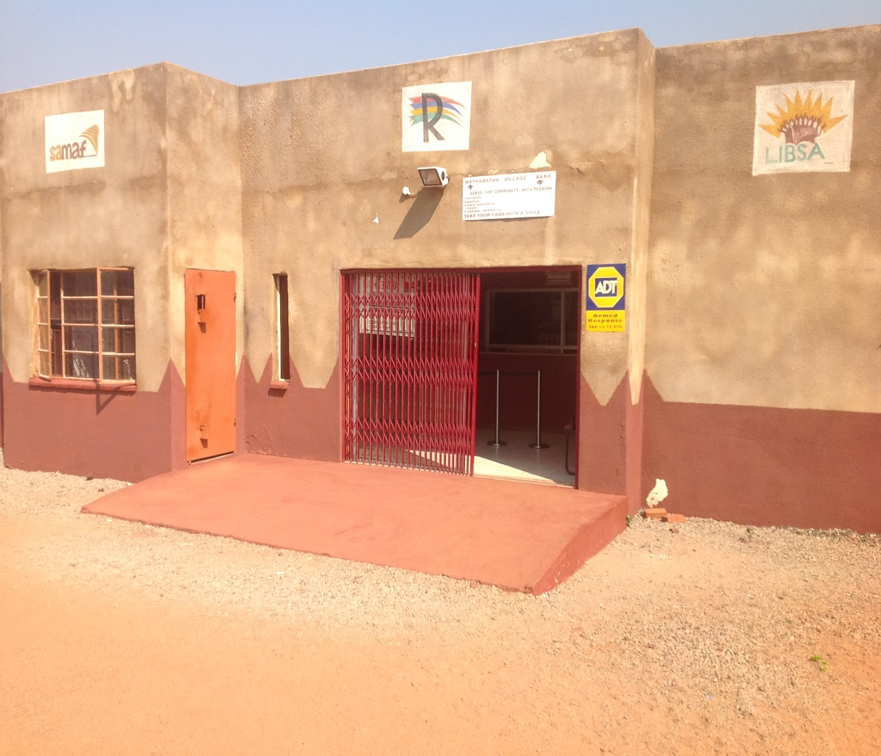
EXAMPLE OF A FINANCIAL SERVICES BUILDING
Mathabatha Financial Co-operative
is situated in Ga-Mathabatha Village,
Limpopo Province. It received a
funding from sefa (ex-samaf) of
R1,3 million i.e. R820K capacity-building grant and R480K on-lending loans. Currently It has
Over 1000 members with a savings book of over R1 million and loan book of approximately R600K.

Slide 15
sefa’s RELATIONSHIP WITH CBDA
Co-operations agreement;
Special Projects-Banking Platform (under negotiations)
  CBDA describes banking platform as:
    “A set of services that enables CFIs to improve management of their organizations
      Offer their members fully automated banking products and services
    These services will include but not limited to:
      Necessary information technology systems
      Enable connectivity to the NPS
      E.g. ability to issue and use debit cards for use at ATMs and POS devices.”

Slide 16
HOW A FINANCIAL CO-OPERATIVE IS FINANCED
sefa= 15% of CFI’s total assets
Member Economic Participation
BY INVESTING IN THE CO-OPERATIVES , YOU ARE INVESTING IN THE FUTURE GENERATION

Slide 17
FINANCIAL SUSTAINABILITY OF CFIs
Membership fees ,annual subscriptions, interest on loans ,external credit which is subject to 15% of total assets cap etc. are not sufficient to financially sustain the CFI.
The question is:
What does a CFI need to sustain itself financially ?
The answer is simple:
A CFI must be creative and innovative whilst CFIs Regulator/Supervisor must create regulatory conditions and environment conducive to creativity and innovation.
Creativity is the ability to develop new ideas and discover new ways of looking at problems and opportunities whilst innovation is creating a value out of a new idea, new prodcuts,new services or new ways of doing things.
.

Slide 18
WRITING CREATIVITY AND INNOVATIVE STORY FOR CFIs
Personally ,as a co-operator ,I am challenging the delegates here today to write a new story for the CFIs movement. A new creativity and innovative story which will assist CFIs to become financial and operational sustainable.
Does the presenter have creativity and innovative story to tell ?
Yes , and this is the story:
Establishment of non-financial co-operatives by CFIs to be used as commercial vehicles. Such co-operatives will become juristic members of the CFIs which is allowed in terms of the Amended Co-operatives Act.
CFIs can through their juristic members tender for government projects. These will create jobs for CFIs members and increase the revenue stream of the CFIs.

Slide 19

THANK YOU
N.J Gumbo
Co-operatives Specialist
Eco Fusion 5
Witch-Hazel Street
Centurion
012-748 9646
072 429 2067
jacobg@sefa.org.za
My mother was a kitchen girl , father a garden boy and I am a co-operator

